Slide 1
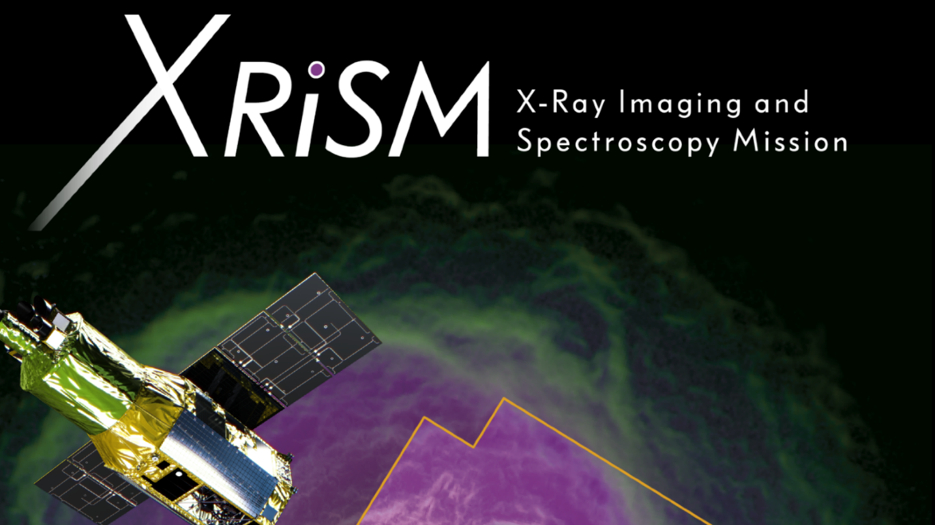
G1:
Alex (Chen Li)
Haolan Wang
Hongwei Huang
Xinchen Miao
1G: Alex (Chen Li)

Slide 2
Contents
Abstract and Introduction
1 Team Management
2 Design and Engineering Challenges
2.1 Team Management of XRISM
2.2 Instruments onboard XRISM
2.2.1 XMA (X-ray Mirror Assembly)
2.2.2 Resolve
2.2.3 Xtend
2.2.4 Parameters, Effective Area, Energy Resolution
2.3 AOCS (Attitude and Orbit Control System)
3 Science Goals
4 Summary and Discussions
References

Slide 3
Contents
Abstract and Introduction
1 Team Management
2 Design and Engineering Challenges
2.1 Team Management of XRISM
2.2 Instruments onboard XRISM
2.2.1 XMA (X-ray Mirror Assembly)
2.2.2 Resolve
2.2.3 Xtend
2.2.4 Parameters, Effective Area, Energy Resolution
2.3 AOCS (Attitude and Orbit Control System)
3 Science Goals
4 Summary and Discussions
References

Slide 4
Abstract and Introduction
Why in space?
The atmosphere is opaque to X-ray, which is a good thing for life.
The importance of XRISM?
XRISM is the only international X-ray observatory project of its period, otherwise we will have a 13-year blank period in soft X-ray observation, because of the failure of Hitomi in 2016.^{[2]}
How did its predecessor Hitomi fail?
inertial reference wheel→attitude control system→reaction wheels→rotated really fast→broke away^{[2]}
Whose idea is this?
Led by JAXA, in collaboration with NASA, ESA, etc.^{[1]}
Instruments?
Resolve (Soft X-ray Spectrometer), Xtend (Soft X-ray Imager)…^{[1][2][3][5]}
Science Goals?
Galaxy & Cluster Evolution, Diffuse Gas in Local Environment, Cosmic Plasma, Compact Objects, The Lives and Deaths of Stars…^{[1][3][4][5]}

Slide 5
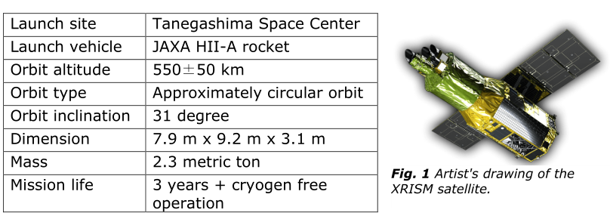
Abstract and Introduction
About the launch?^{[5]}
Due to launch in 2021^{[8]}, 2022^{[1][3]}, 2023^{[2]}…
^{[5]}

Slide 6
Contents
Abstract and Introduction
1 Team Management
2 Design and Engineering Challenges
2.1 Team Management of XRISM
2.2 Instruments onboard XRISM
2.2.1 XMA (X-ray Mirror Assembly)
2.2.2 Resolve
2.2.3 Xtend
2.2.4 Parameters, Effective Area, Energy Resolution
2.3 AOCS (Attitude and Orbit Control System)
3 Science Goals
4 Summary and Discussions
References

Slide 7
1 Team Management
Pre-research(Wiki, arXiv, NASA/ADS) and Classification
Schedule.pdf
Schedule2.pdf
^{[2]}

Slide 8
Contents
Abstract and Introduction
1 Team Management
2 Design and Engineering Challenges
2.1 Team Management of XRISM
2.2 Instruments onboard XRISM
2.2.1 XMA (X-ray Mirror Assembly)
2.2.2 Resolve
2.2.3 Xtend
2.2.4 Parameters, Effective Area, Energy Resolution
2.3 AOCS (Attitude and Orbit Control System)
3 Science Goals
4 Summary and Discussions
References

Slide 9
Contents
Abstract and Introduction
1 Team Management
2 Design and Engineering Challenges
2.1 Team Management of XRISM
2.2 Instruments onboard XRISM
2.2.1 XMA (X-ray Mirror Assembly)
2.2.2 Resolve
2.2.3 Xtend
2.2.4 Parameters, Effective Area, Energy Resolution
2.3 AOCS (Attitude and Orbit Control System)
3 Science Goals
4 Summary and Discussions
References

Slide 10
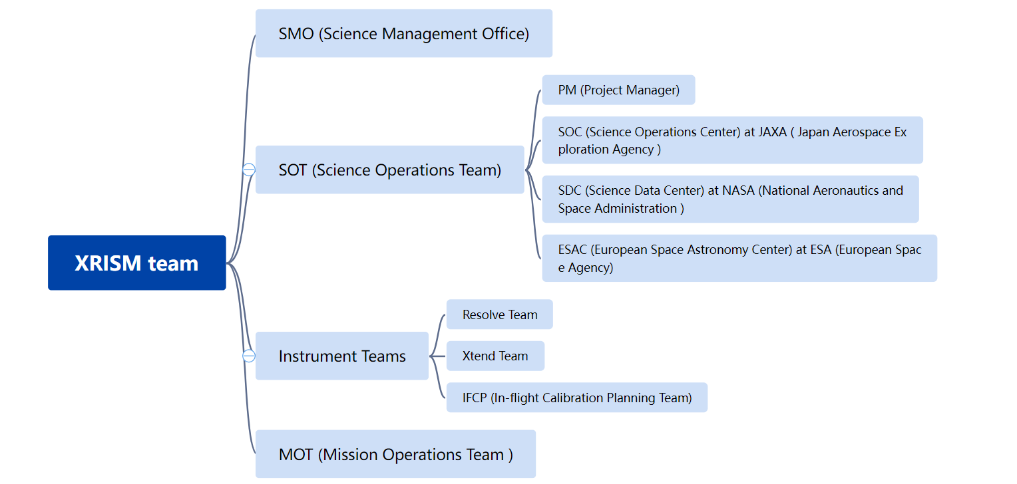
2.1 Team Management of XRISM^{[4]}
Supreme Court
President

Slide 11
2.1 Team Management of XRISM^{[4]}
Science Operations (by conducting Guest Observation)→Operations Concept→structure of SOT & interactions with other subgroups and Guest Observations→timeline

Slide 12
2.1 Team Management of XRISM^{[4]}
Science Operations (by conducting Guest Observation)→Operations Concept→structure of SOT & interactions with other subgroups and Guest Observations→timeline
SO1 Guest Observer (GO) program and data distribution
SO2 Distribution of analysis software and calibration database
SO3 GO supporting activities
SO4 Performance verification and optimization (PVO) activities

Slide 13
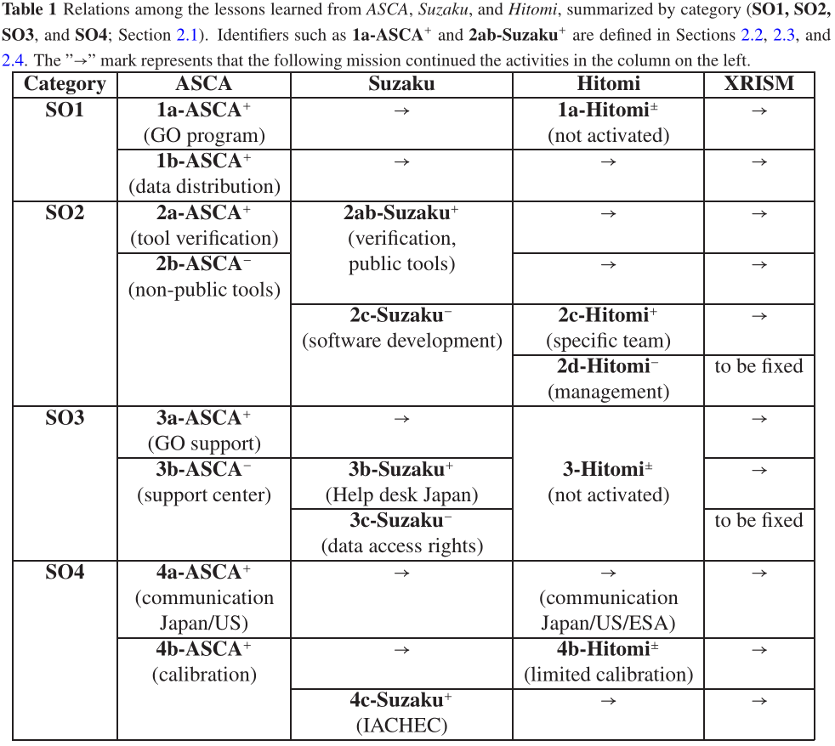
2.1 Team Management of XRISM^{[4]}
Science Operations (by conducting Guest Observation)→Operations Concept→structure of SOT & interactions with other subgroups and Guest Observations→timeline
^{[4]}

Slide 14
2.1 Team Management of XRISM^{[4]}
Science Operations (by conducting Guest Observation)→Operations Concept→structure of SOT & interactions with other subgroups and Guest Observations→timeline
OC1 Clear division between spacecraft operations and science operations is required so that the scientists can concentrate on science operations.
OC2 The plans for the operations, including the team structure and interfaces.
OC3 All members of the operations should be appointed by the agencies, and all activities should be performed as well-defined tasks with clear due dates, that continue to work until the end of the mission.
SOT (Science Operations Team) & MOT (Mission Operations Team)

Slide 15
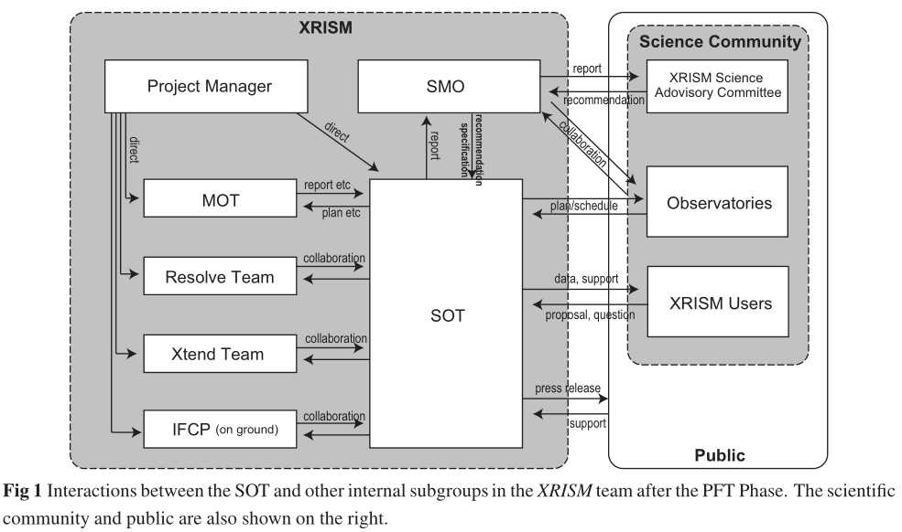
2.1 Team Management of XRISM^{[4]}
Science Operations (by conducting Guest Observation)→Operations Concept→structure of SOT & interactions with other subgroups and Guest Observations→timeline
PM
^{[4]}
SMO (Science Management Office)
SOT (Science Operations Team)
MOT (Mission Operations Team)

Slide 16
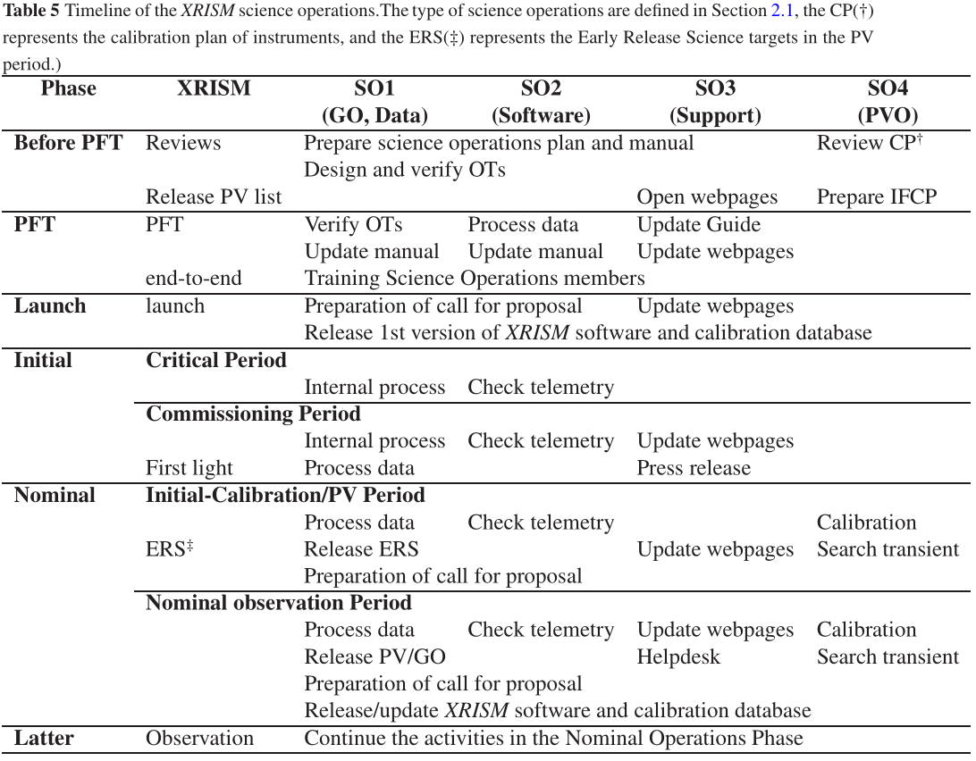
2.1 Team Management of XRISM^{[4]}
Science Operations (by conducting Guest Observation)→Operations Concept→structure of SOT & interactions with other subgroups and Guest Observations→timeline
^{[4]}
PFT(Proto-Flight Test)
PV(the Performance Verification)
SO(Science Operation)
GO(Guest Observer)

Slide 17
Contents
Abstract and Introduction
1 Team Management
2 Design and Engineering Challenges
2.1 Team Management of XRISM
2.2 Instruments onboard XRISM
2.2.1 XMA (X-ray Mirror Assembly)
2.2.2 Resolve
2.2.3 Xtend
2.2.4 Parameters, Effective Area, Energy Resolution
2.3 AOCS (Attitude and Orbit Control System)
3 Science Goals
4 Summary and Discussions
References

Slide 18
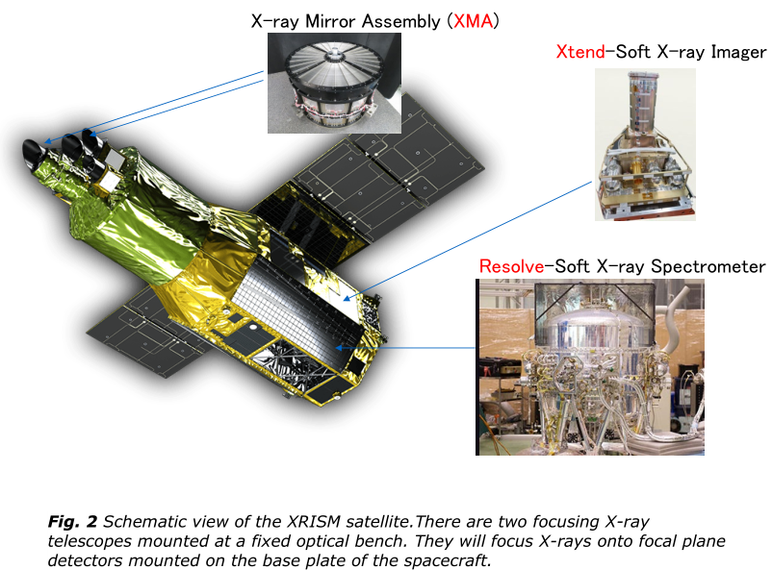
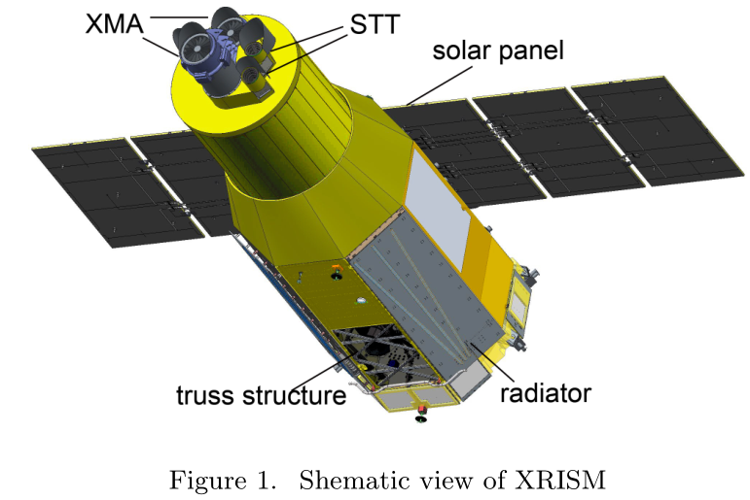
2.2 Instruments onboard XRISM
Outside
^{[5]}
^{[13]}

Slide 19
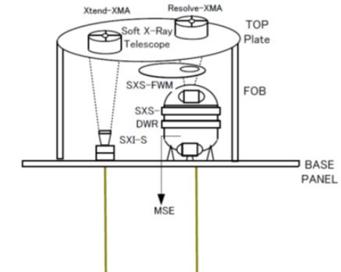
2.2 Instruments onboard XRISM
Inside (Partial)
^{[13]}

Slide 20
Contents
Abstract and Introduction
1 Team Management
2 Design and Engineering Challenges
2.1 Team Management of XRISM
2.2 Instruments onboard XRISM
2.2.1 XMA (X-ray Mirror Assembly)
2.2.2 Resolve
2.2.3 Xtend
2.2.4 Parameters, Effective Area, Energy Resolution
2.3 AOCS (Attitude and Orbit Control System)
3 Science Goals
4 Summary and Discussions
References

Slide 21
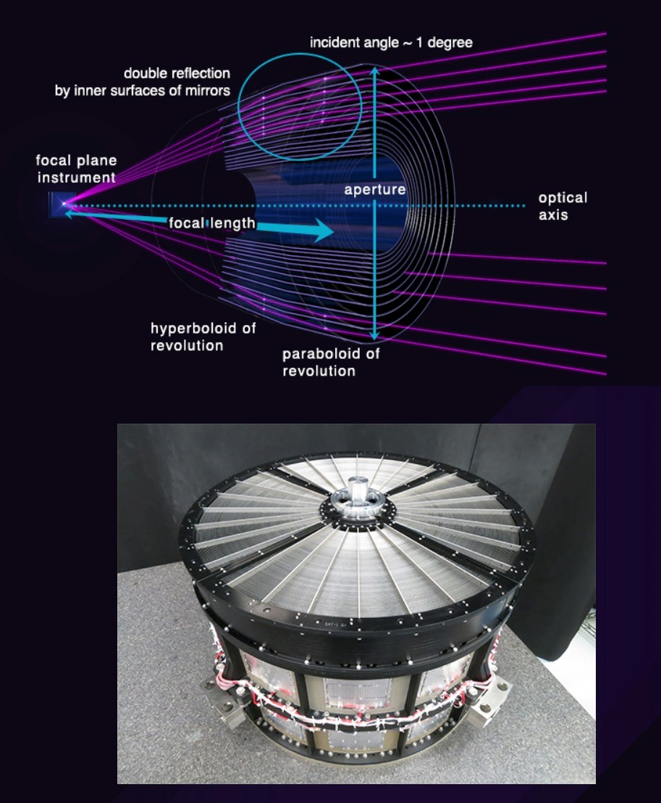
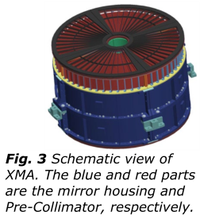
2.2.1 XMA (X-ray Mirror Assembly)
^{[1]}
^{[5]}

Slide 22
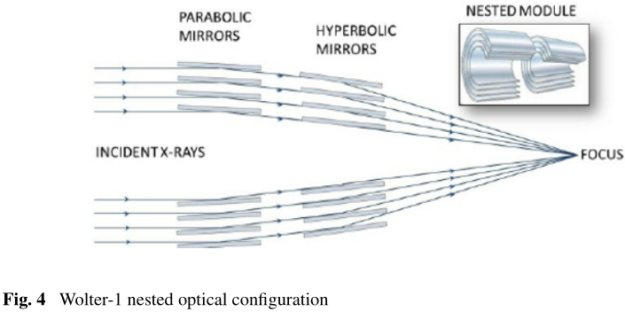
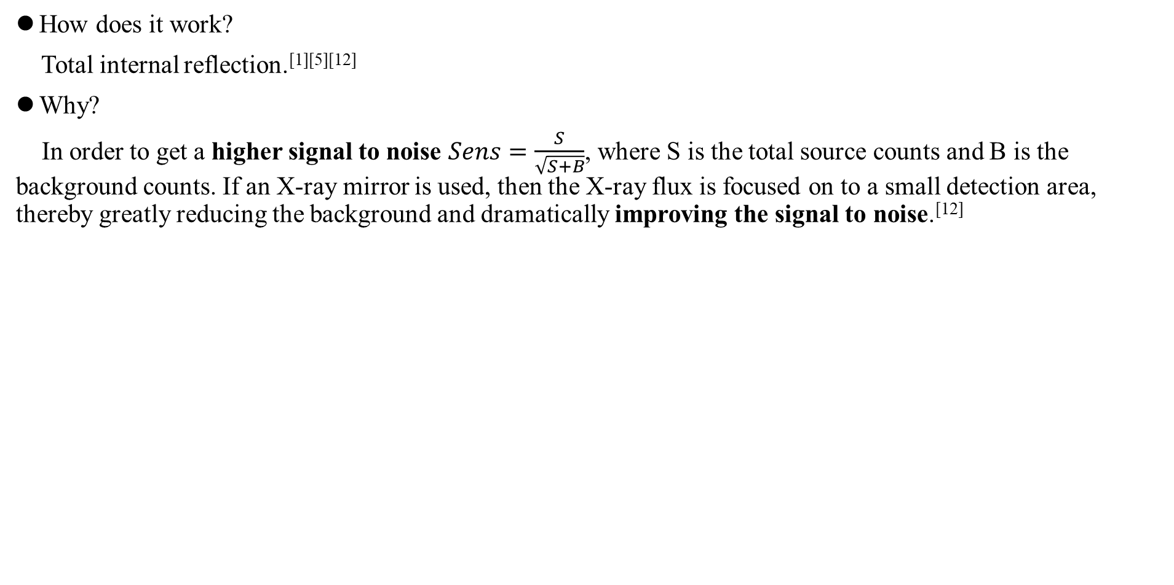
2.2.1 XMA (X-ray Mirror Assembly)
How does it work?
Total internal reflection.^{[1][5][12]}
Why?
In order to get a higher signal to noise $Sens=\frac{S}{\sqrt{S+B}}$, where S is the total source counts and B is the background counts. If an X-ray mirror is used, then the X-ray flux is focused on to a small detection area, thereby greatly reducing the background and dramatically improving the signal to noise.^{[12]}
^{[12]}

Slide 23
2.2.1 XMA (X-ray Mirror Assembly)
What does it consist of?^{[5]}
The Reflectors (Mirrors) are fixed to support-bars with adhesive→high angular resolution
Pre-Collimator: → reduce Stray light or contaminating X-rays from outside of the FoV (field of view)
Thermal Shield: in front of the Pre-Collimator.→stabilize the thermal environment of the XMA.
^{[5]}

Slide 24
Contents
Abstract and Introduction
1 Team Management
2 Design and Engineering Challenges
2.1 Team Management of XRISM
2.2 Instruments onboard XRISM
2.2.1 XMA (X-ray Mirror Assembly)
2.2.2 Resolve
2.2.3 Xtend
2.2.4 Parameters, Effective Area, Energy Resolution
2.3 AOCS (Attitude and Orbit Control System)
3 Science Goals
4 Summary and Discussions
References

Slide 25
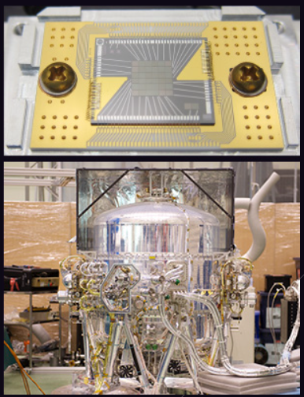
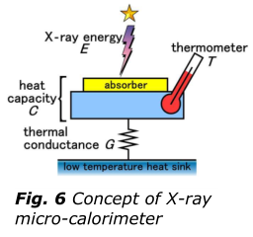
2.2.2 Resolve
^{[1]}
^{[5]}

Slide 26
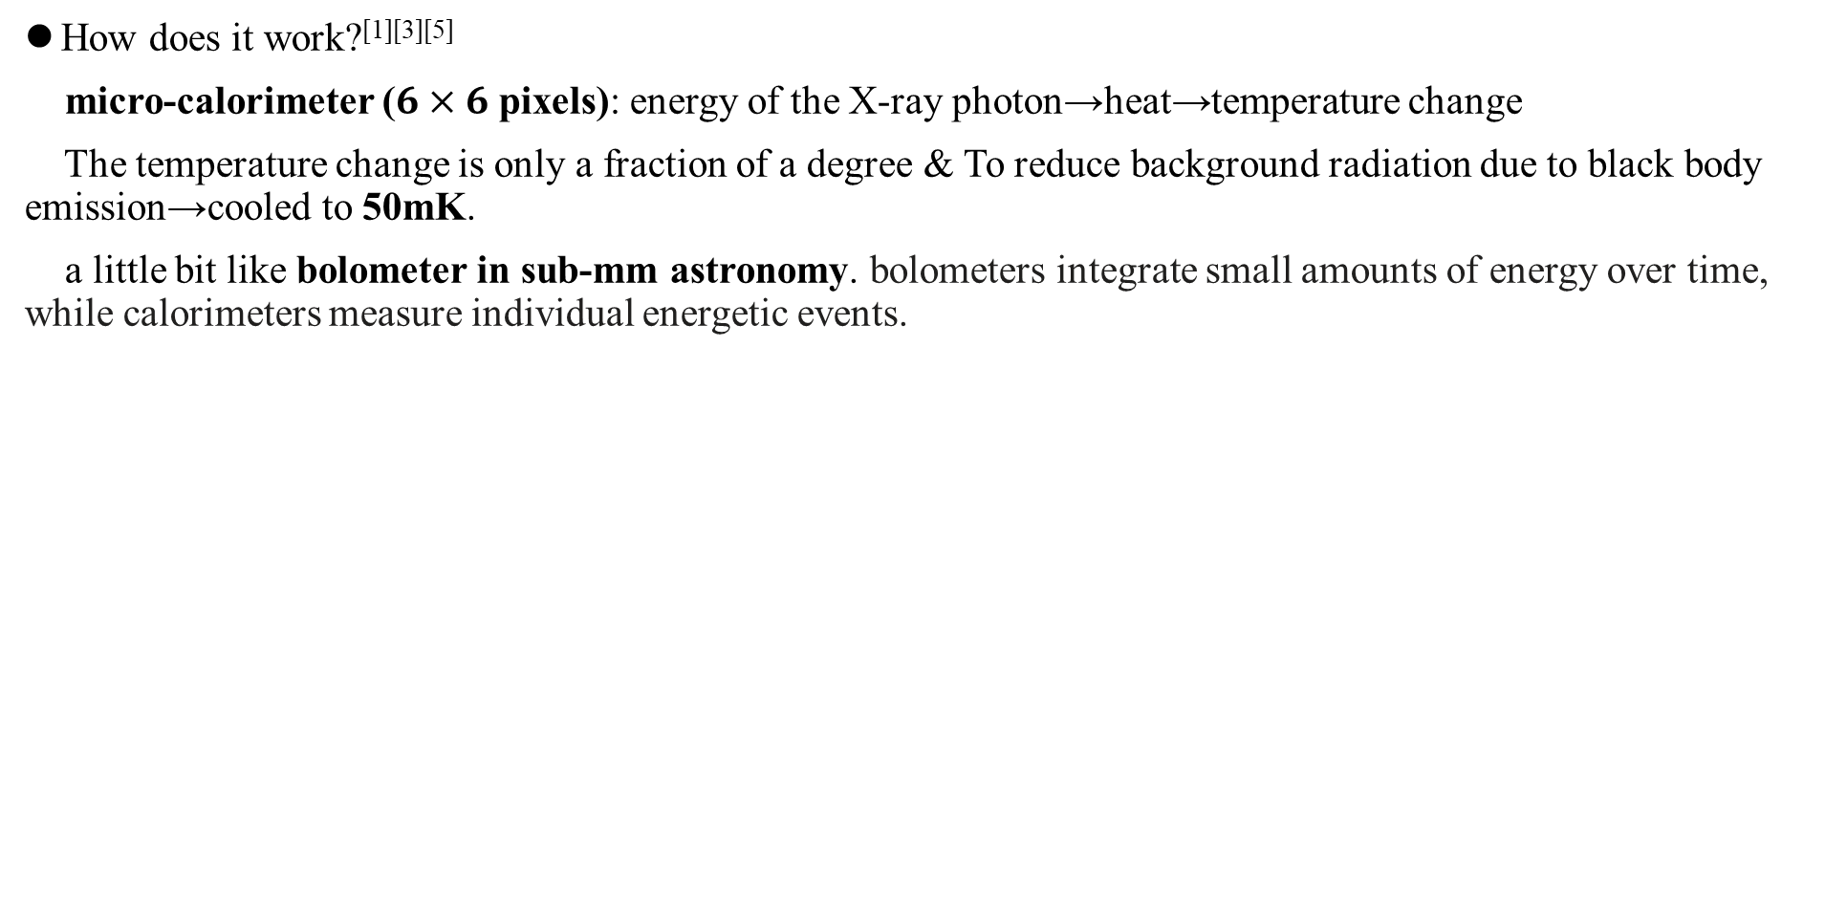
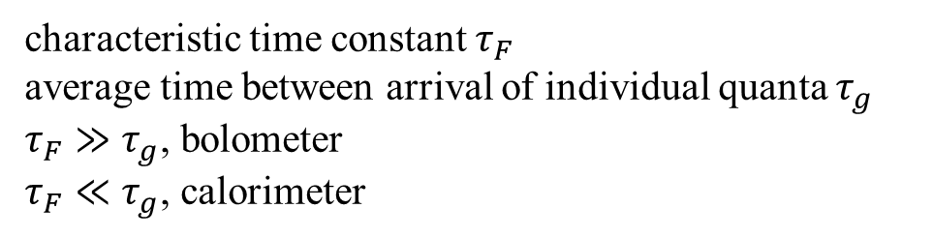
2.2.2 Resolve
How does it work?^{[1][3][5]}
micro-calorimeter ($6×6$ pixels): energy of the X-ray photon→heat→temperature change
The temperature change is only a fraction of a degree & To reduce background radiation due to black body emission→cooled to 50mK.
a little bit like bolometer in sub-mm astronomy. bolometers integrate small amounts of energy over time, while calorimeters measure individual energetic events.
^{[5]}
characteristic time constant $τ_{F}$
average time between arrival of individual quanta $τ_{g}$
$τ_{F}≫$ $τ_{g}$, bolometer
$τ_{F}≪$ $τ_{g}$, calorimeter

Slide 27
2.2.2 Resolve
What does it consist of?
Cooling System (Dewar, Aperture Baffle, Vibration Isolation System, Gate Valve)^{[5][6][10]}, Filter Wheel^{[5][6]}, MXS (Modulated X-ray Source)^{[2][5][6]}

Slide 28
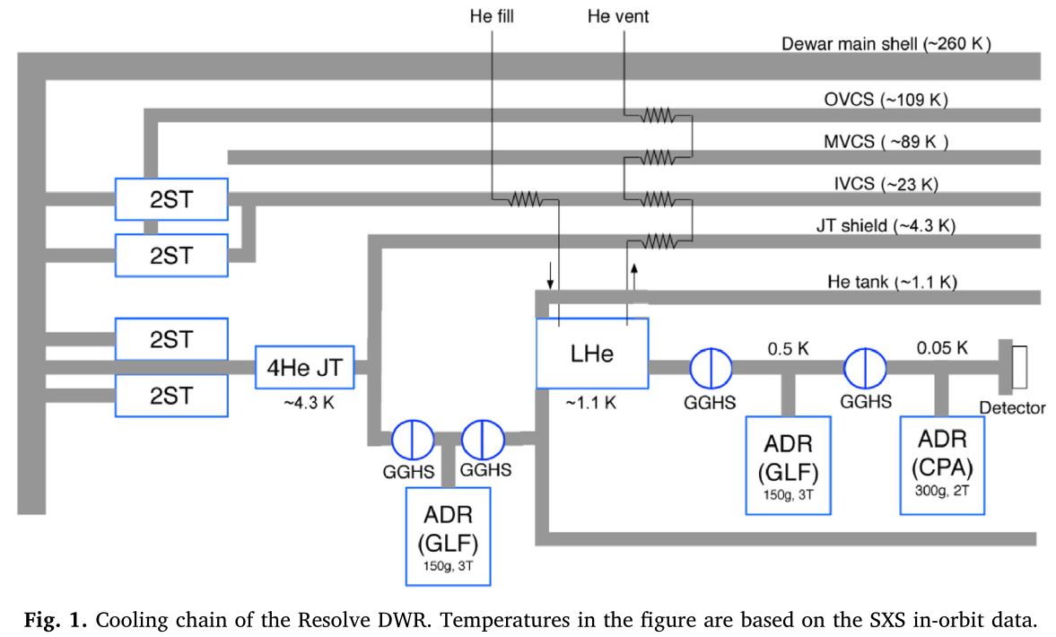
2.2.2 Resolve
What does it consist of?
Cooling System (Dewar, Aperture Baffle, Vibration Isolation System, Gate Valve)^{[5][6][10]}, Filter Wheel^{[5][6]}, MXS (Modulated X-ray Source)^{[2][5][6]}
^{[6]}
Can work with or without cryogen.^{[5][6][10]}

Slide 29
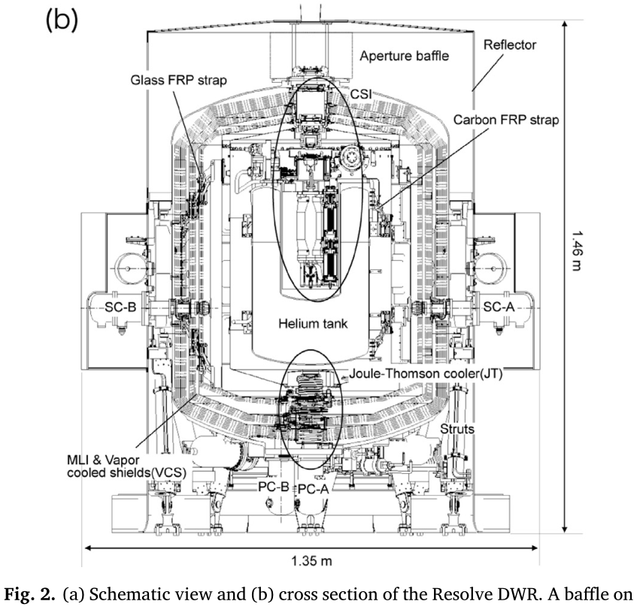
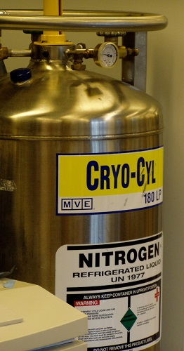
2.2.2 Resolve
What does it consist of?
Cooling System (Dewar, Aperture Baffle, Vibration Isolation System, Gate Valve)^{[5][6][10]}, Filter Wheel^{[5][6]}, MXS (Modulated X-ray Source)^{[2][5][6]}
^{[6]}
Basically a refrigerator.

Slide 30
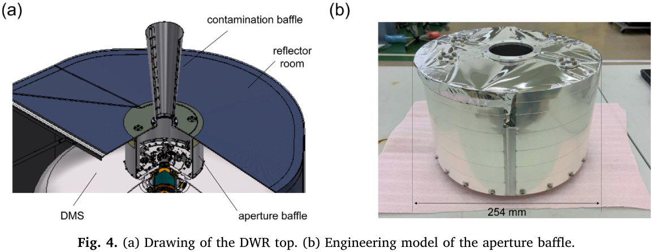
2.2.2 Resolve
What does it consist of?
Cooling System (Dewar, Aperture Baffle, Vibration Isolation System, Gate Valve)^{[5][6][10]}, Filter Wheel^{[5][6]}, MXS (Modulated X-ray Source)^{[2][5][6]}
^{[6]}
→protect Resolve from optical light leakage.^{[6]}

Slide 31
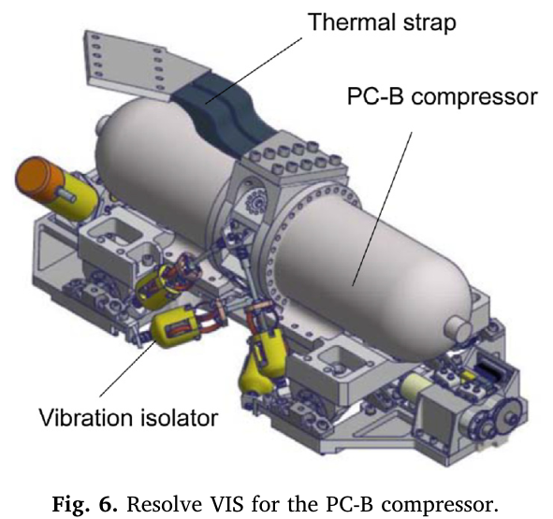
2.2.2 Resolve
What does it consist of?
Cooling System (Dewar, Aperture Baffle, Vibration Isolation System, Gate Valve)^{[5][6][10]}, Filter Wheel^{[5][6]}, MXS (Modulated X-ray Source)^{[2][5][6]}
^{[6]}
→ reduce micro vibration due to the mechanical coolers which was found to significantly degrade the energy resolution.^{[6]}

Slide 32
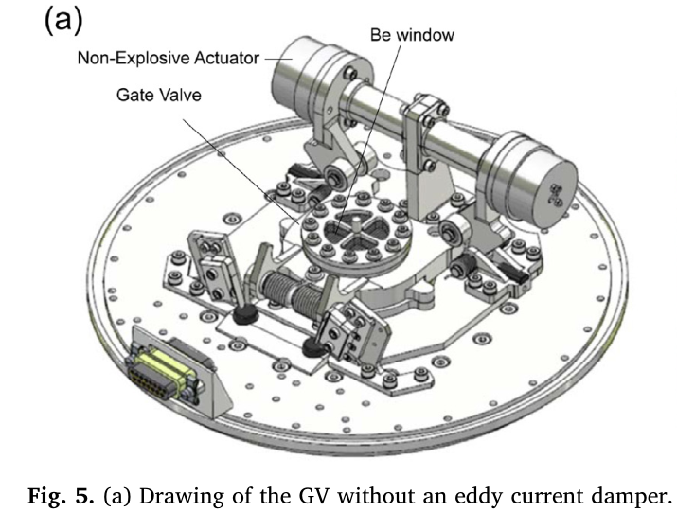
2.2.2 Resolve
What does it consist of?
Cooling System (Dewar, Aperture Baffle, Vibration Isolation System, Gate Valve)^{[5][6][10]}, Filter Wheel^{[5][6]}, MXS (Modulated X-ray Source)^{[2][5][6]}
^{[6]}
Closed at first, only open once during the operation and stay open afterwards.
→to seal the vacuum inside the Dewar and to protect filters during ground operations and launch.^{[6][10]}

Slide 33
2.2.2 Resolve
What does it consist of?
Cooling System (Dewar, Aperture Baffle, Vibration Isolation System, Gate Valve)^{[5][6][10]}, Filter Wheel^{[5][6]}, MXS (Modulated X-ray Source)^{[2][5][6]}
^{[6]}
Closed at first, only open once during the operation and stay open afterwards.
→to seal the vacuum inside the Dewar and to protect filters during ground operations and launch.^{[6][10]}
We want the data when it is closed!

Slide 34
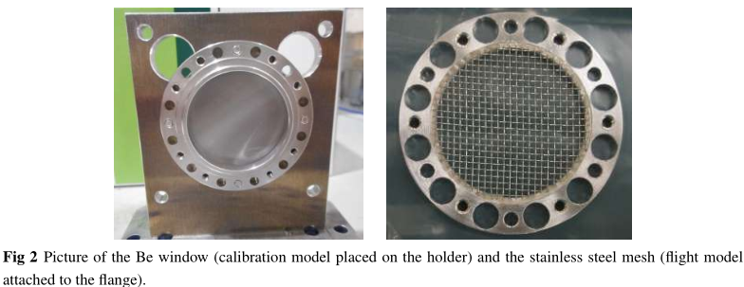
2.2.2 Resolve
What does it consist of?
Cooling System (Dewar, Aperture Baffle, Vibration Isolation System, Gate Valve)^{[5][6][10]}, Filter Wheel^{[5][6]}, MXS (Modulated X-ray Source)^{[2][5][6]}
^{[10]}
Gate Valve: Beryllium window + stainless steel mesh.

Slide 35
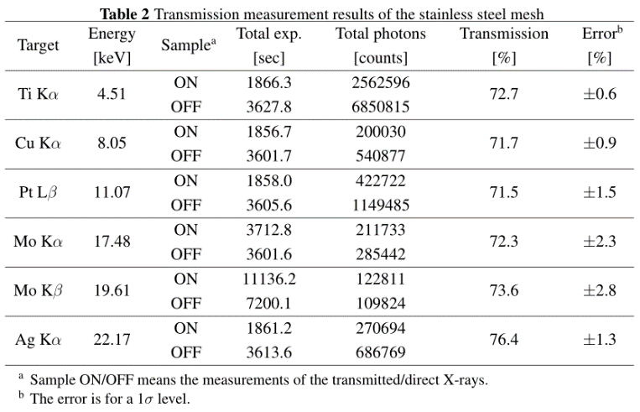
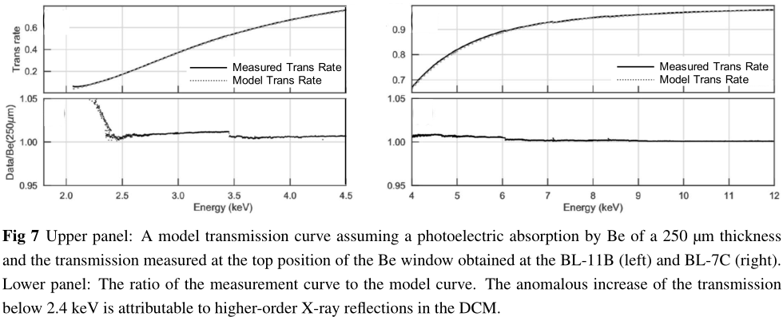
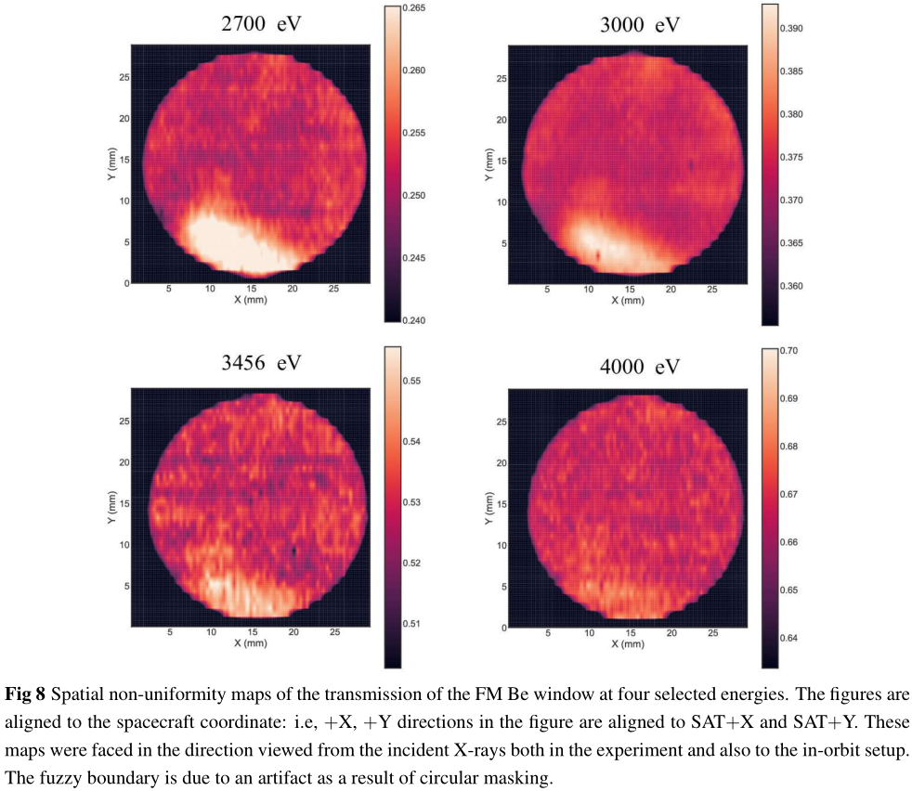
2.2.2 Resolve
What does it consist of?
Cooling System (Dewar, Aperture Baffle, Vibration Isolation System, Gate Valve)^{[5][6][10]}, Filter Wheel^{[5][6]}, MXS (Modulated X-ray Source)^{[2][5][6]}
^{[10]}
^{[10]}
^{[10]}
[10] measured the energy dependence of the X-ray transmission of the window and the mesh, and the spatial dependence of the X-ray transmission of the window. [10] modeled the total transmission of the GV as $T\left(E\right)=T_{Be}\left(E\right)\{f+(1−f)T_{mesh}\left(E\right)\}$

Slide 36
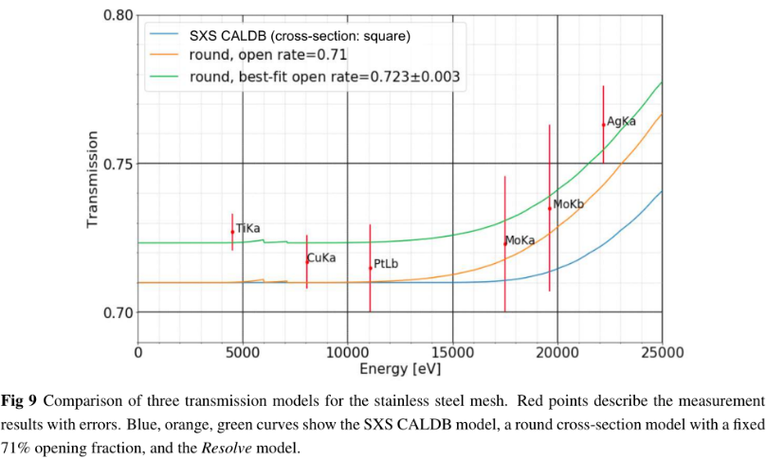
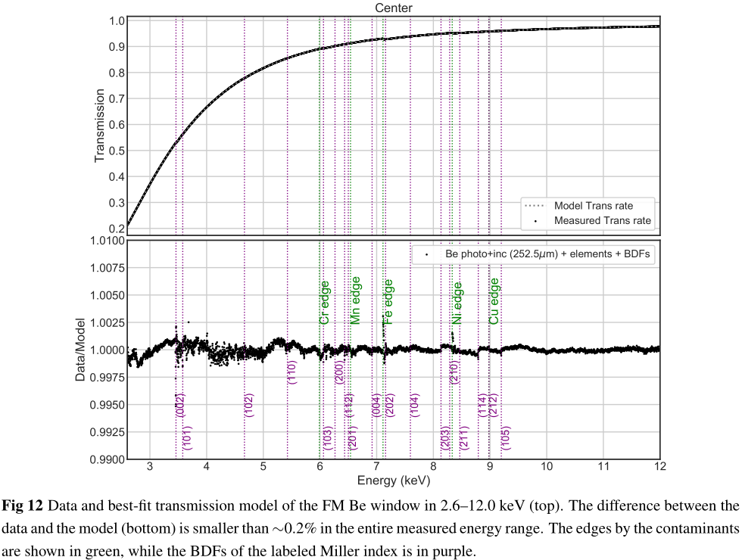
2.2.2 Resolve
What does it consist of?
Cooling System (Dewar, Aperture Baffle, Vibration Isolation System, Gate Valve)^{[5][6][10]}, Filter Wheel^{[5][6]}, MXS (Modulated X-ray Source)^{[2][5][6]}
^{[10]}
^{[10]}
[10] measured the energy dependence of the X-ray transmission of the window and the mesh, and the spatial dependence of the X-ray transmission of the window. [10] modeled the total transmission of the GV as $T\left(E\right)=T_{Be}\left(E\right)\{f+(1−f)T_{mesh}\left(E\right)\}$

Slide 37
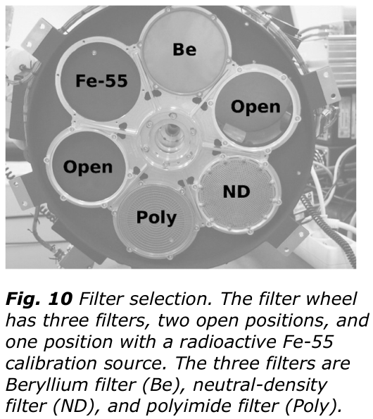
2.2.2 Resolve
What does it consist of?
Cooling System (Dewar, Aperture Baffle, Vibration Isolation System, Gate Valve)^{[5][6][10]}, Filter Wheel^{[5][6]}, MXS (Modulated X-ray Source)^{[2][5][6]}
^{[5]}
→enhance the dynamic range of the Resolve for bright sources.^{[5]}

Slide 38
2.2.2 Resolve
What does it consist of?
Cooling System (Dewar, Aperture Baffle, Vibration Isolation System, Gate Valve)^{[5][6][10]}, Filter Wheel^{[5][6]}, MXS (Modulated X-ray Source)^{[2][5][6]}
XRISM will observe the source sat to conduct absolute calibration of its telescopes, thus functioning as an in-orbit X-ray "standard candle".^{[2]}
will be used for accurate energy-scale calibration in orbit.^{[5]}
MXS (Modulated X-ray Source, X-ray generator)^{[6]}

Slide 39
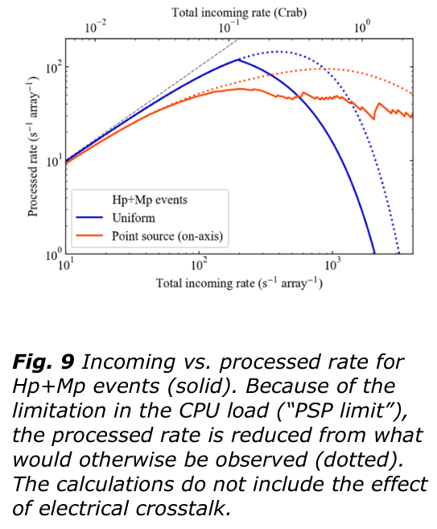
2.2.2 Resolve
The PSP(digital processor) has a “PSP limit”. bright sources→filter, offset pointings, or both.^{[5]}
^{[5]}

Slide 40
Contents
Abstract and Introduction
1 Team Management
2 Design and Engineering Challenges
2.1 Team Management of XRISM
2.2 Instruments onboard XRISM
2.2.1 XMA (X-ray Mirror Assembly)
2.2.2 Resolve
2.2.3 Xtend
2.2.4 Parameters, Effective Area, Energy Resolution
2.3 AOCS (Attitude and Orbit Control System)
3 Science Goals
4 Summary and Discussions
References

Slide 41
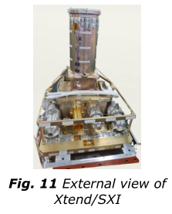
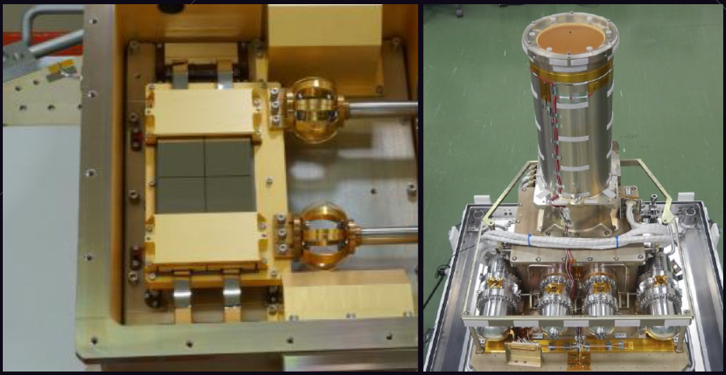
2.2.3 Xtend
How does it work?^{[1][5]}
X-ray CCD camera: photoelectric effect^{[1]}
^{[5]}
^{[1]}

Slide 42
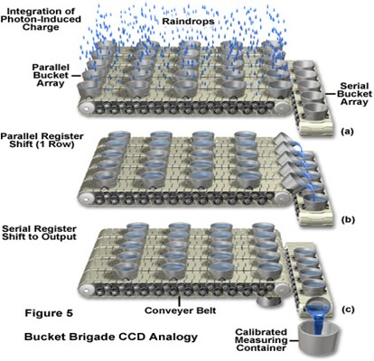
2.2.3 Xtend
How does it work?^{[1][5]}
X-ray CCD camera: photoelectric effect^{[1]}

Slide 43
2.2.3 Xtend
Flaws?
1.CTI (charge transfer inefficiency)^{[5][9]}, 2.Optical light leakages^{[5][8]}, 3.Pile-Up^{[5][11]}, 4.Radiation Hardness^{[7][14]}

Slide 44
2.2.3 Xtend
1.CTI (charge transfer inefficiency)^{[5][9]}: the fraction of charge loss per transfer.
→①a charge injection structure, which injects artificial charge to pixels periodically to fill traps which cause CTI.^{[9]}

Slide 45
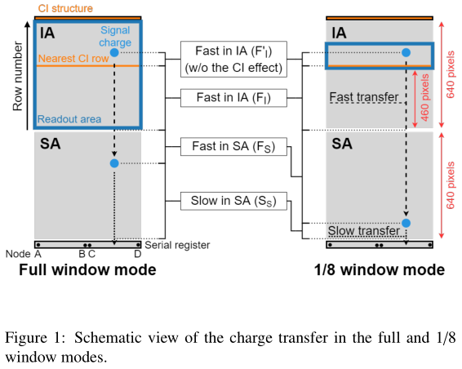
2.2.3 Xtend
1.CTI (charge transfer inefficiency)^{[5][9]}: the fraction of charge loss per transfer.
→②Each pixel consists of 2 areas: imaging area (IA), storage area (SA), we can model the loss.^{[9]}
^{[9]}
A comparison of the amounts of trailing charge in the full and 1/8 window mode data indicated that the charge loss due to a fast transfer in the IA is larger than that in the SA. Considering the area dependence as well as the transfer-time dependence, our new CTI model was able to reproduce the charge loss.^{[9]}

Slide 46
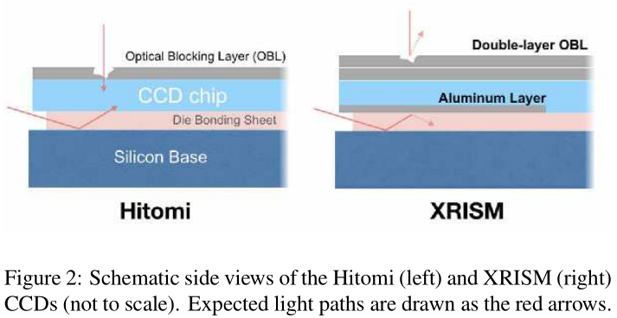
2.2.3 Xtend
2.Optical light leakages^{[5][8]}
^{[8]}
The origin of “pinholes” is voids generated in the Aluminum OBL (Optical Blocking Layer)→double-layer OBL
The origin of the end-surface leakage is the transparent die bonding sheet→Aluminum Layer

Slide 47
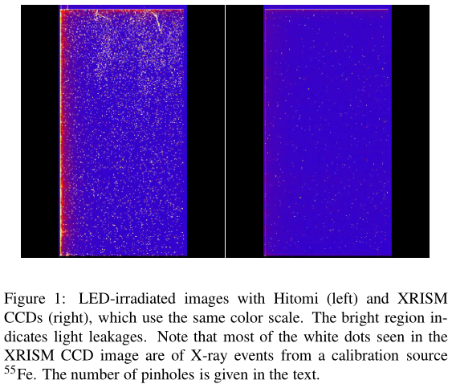
2.2.3 Xtend
2.Optical light leakages^{[5][8]}
→Double-layer OBL (Optical Blocking Layer), Aluminum Layer
^{[8]}

Slide 48
2.2.3 Xtend
3.Pile-Up^{[5][11]}: When multiple photons are analyzed as a single event.
→①CCD clocking modes with different exposure times (4, 0.5, and 0.06 s).^{[5]}

Slide 49
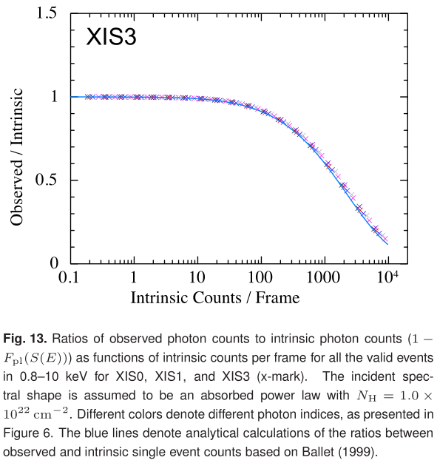
2.2.3 Xtend
3.Pile-Up^{[5][11]}: When multiple photons are analyzed as a single event.
→②a simulation-based method of spectral analysis for pile-up affected data.^{[11]}→get the energy of X-ray photon from the number of emitted electrons^{[5]}
^{[11]}

Slide 50
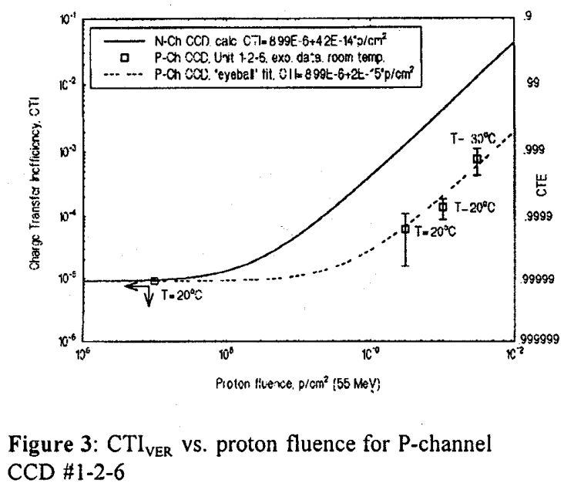
2.2.3 Xtend
4.Radiation Hardness: →p-channel^{[14]} CCD with a notch structure^{[7]}
→reduce dark current, p-channel CCDs would be more radiation hard than conventional n-channel CCDs.^{[14]}
^{[14]}

Slide 51
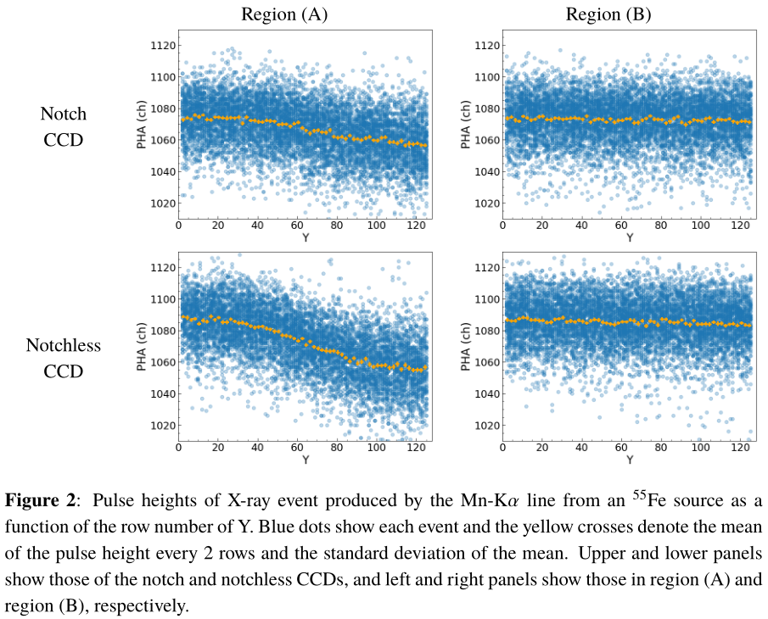
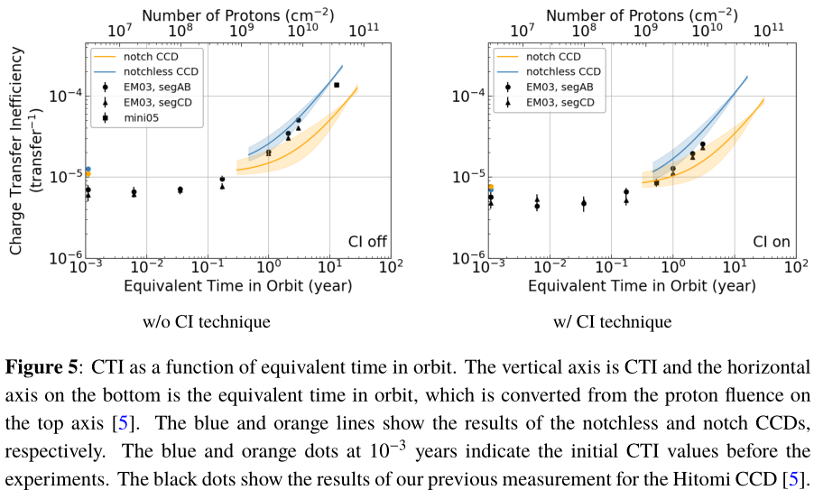
2.2.3 Xtend
4.Radiation Hardness: →p-channel^{[14]} CCD with a notch structure^{[7]}
The notch structure is a narrow implant in the CCD channel confining a charge packet to a fraction of the pixel volume in an additional potential well.
^{[7]}
^{[7]}
PHA: a way to evaluate CTI

Slide 52
Contents
Abstract and Introduction
1 Team Management
2 Design and Engineering Challenges
2.1 Team Management of XRISM
2.2 Instruments onboard XRISM
2.2.1 XMA (X-ray Mirror Assembly)
2.2.2 Resolve
2.2.3 Xtend
2.2.4 Parameters, Effective Area, Energy Resolution
2.3 AOCS (Attitude and Orbit Control System)
3 Science Goals
4 Summary and Discussions
References

Slide 53
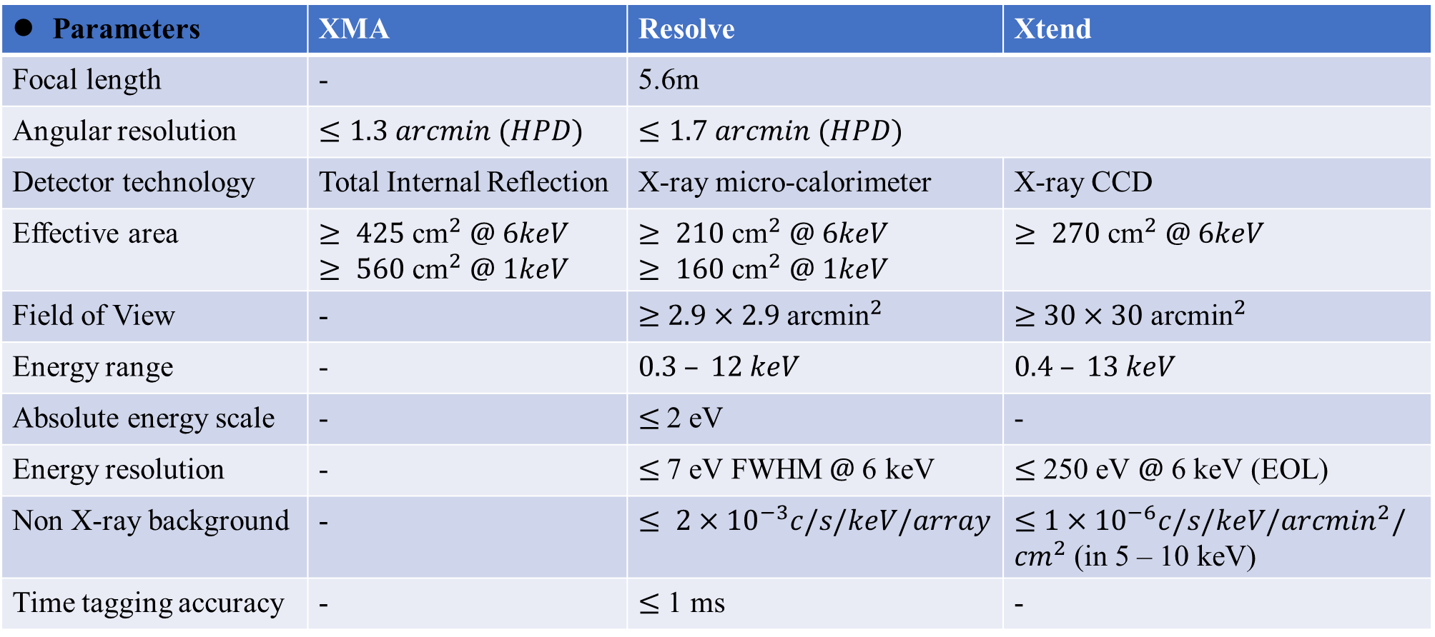
2.2.4 Parameters, Effective Area, Energy Resolution^{[2][3][5][13]}
Parameters | XMA | Resolve | Xtend
Focal length | - | 5.6m
Angular resolution | $$≤1.3 arcmin (HPD)$$ | $$≤1.7 arcmin (HPD)$$
Detector technology | Total Internal Reflection | X-ray micro-calorimeter | X-ray CCD
Effective area | $$≥ 425 {\text{cm}}^{2} @ 6keV$$ $$≥ 560 {\text{cm}}^{2} @ 1keV$$ | $$≥ 210 {\text{cm}}^{2} @ 6keV$$ $$≥ 160 {\text{cm}}^{2} @ 1keV$$ | $≥ 270 {\text{cm}}^{2}$ $@ 6keV$
Field of View | - | $≥$ $2.9×2.9 {\text{arcmin}}^{2}$ | $≥$ $30×30 {\text{arcmin}}^{2}$
Energy range | - | $$0.3 – 12 keV$$ | $$0.4 – 13 keV$$
Absolute energy scale | - | $≤$2 eV | -
Energy resolution | - | $≤$7 eV FWHM$@$6 keV | $≤$ 250 eV $@$ 6 keV (EOL)
Non X-ray background | - | $$≤ 2×{10}^{−3}c/s/keV/array$$ | $≤$ $1×{10}^{−6}c/s/keV/{arcmin}^{2}/{cm}^{2}$ (in 5 – 10 keV)
Time tagging accuracy | - | $≤$ 1 ms | -

Slide 54
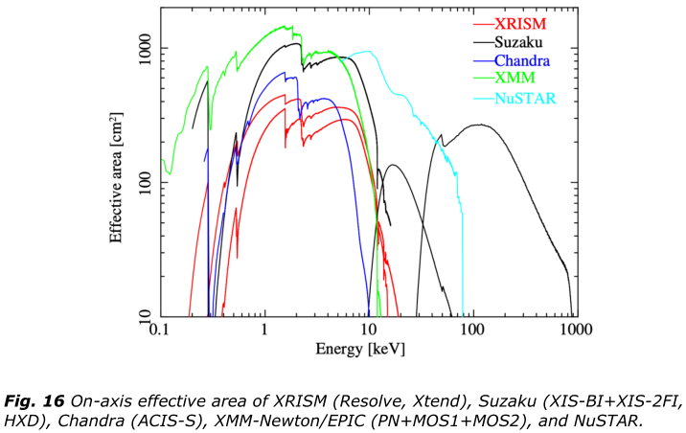
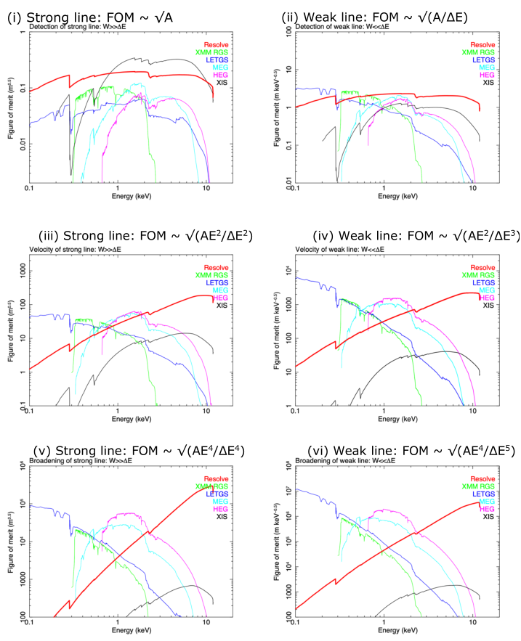
2.2.4 Parameters, Effective Area, Energy Resolution^{[2][3][5][13]}
Effective Area
Energy Resolution
^{[5]}
^{[5]}
Suzaku: 2005-2015
Chandra: 1999-
XMM: 1999-
NuSTAR: 2012-

Slide 55
Contents
Abstract and Introduction
1 Team Management
2 Design and Engineering Challenges
2.1 Team Management of XRISM
2.2 Instruments onboard XRISM
2.2.1 XMA (X-ray Mirror Assembly)
2.2.2 Resolve
2.2.3 Xtend
2.2.4 Parameters, Effective Area, Energy Resolution
2.3 AOCS (Attitude and Orbit Control System)
3 Science Goals
4 Summary and Discussions
References

Slide 56
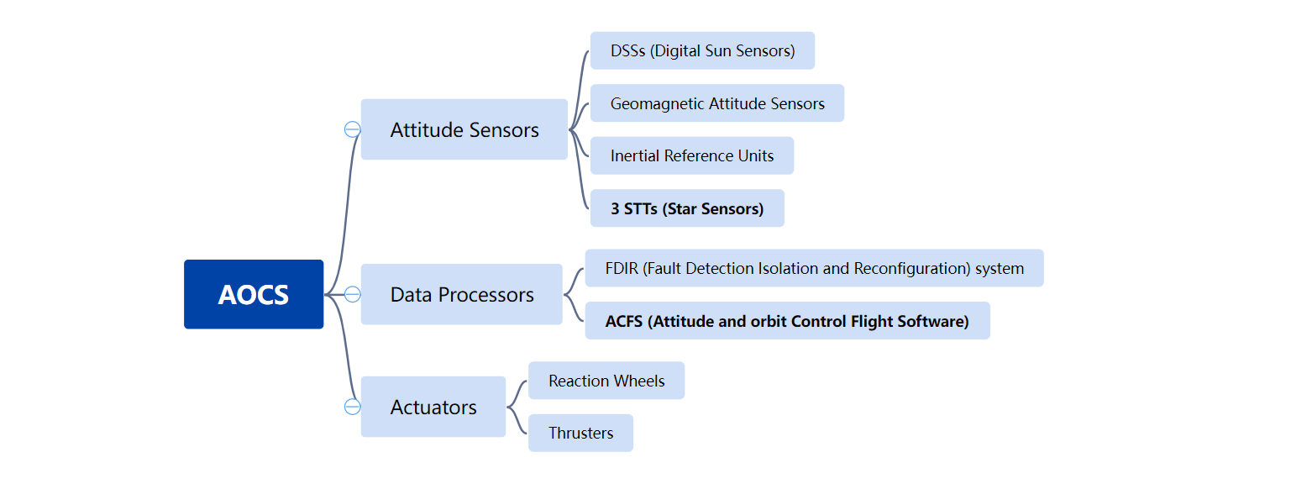
2.3 AOCS (Attitude and Orbit Control System)^{[13]}

Slide 57
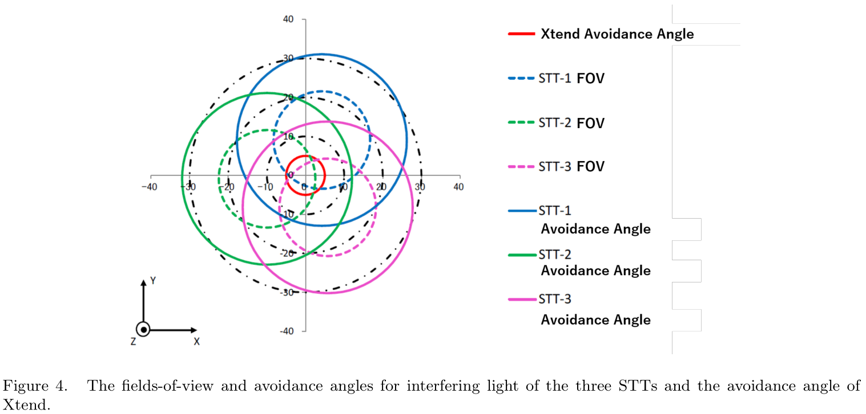
2.3 AOCS (Attitude and Orbit Control System)^{[13]}
3 STTs (Star Sensors)
^{[13]}
^{[13]}
2
Symmetry!

Slide 58
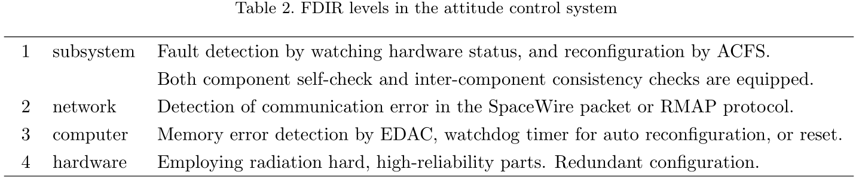
2.3 AOCS (Attitude and Orbit Control System)^{[13]}
ACFS (Attitude and orbit Control Flight Software)
Redundant Configuration: supreme control system, to deal with emergencies, which can reset the whole system.
^{[13]}

Slide 59
Contents
Abstract and Introduction
1 Team Management
2 Design and Engineering Challenges
2.1 Team Management of XRISM
2.2 Instruments onboard XRISM
2.2.1 XMA (X-ray Mirror Assembly)
2.2.2 Resolve
2.2.3 Xtend
2.2.4 Parameters, Effective Area, Energy Resolution
2.3 AOCS (Attitude and Orbit Control System)
3 Science Goals
4 Summary and Discussions
References

Slide 60
3 Science Goals
Proposed (by the XRISM team)^{[1][3][4][5]}
1.Galaxy & Cluster Evolution:
IntraCluster Medium
Chemical Evolution
Dark Matter
2.Diffuse Gas in Local Environment:
InterGalactic Medium
Dust Scattering Halos and Molecular Clouds
Galactic Center
Charge Exchange
3.Cosmic Plasma
4.Compact Objects:
AGN
SMBH
XRB
Ultra-Luminous X-ray sources
5.The Lives and Deaths of Stars:
Star Formation
Supernovae and their Remnants
Exoplanets
Expected (by the public)
1.Galactic & Cluster Evolution^{[27][35]}:
IntraCluster Medium^{[21][29][40][58]}
Chemical Evolution[29][31][34][42][50][55][59][63]
Dark Matter^{[30][43][51][54][60]}
2.InterGalactic Medium^{[27][28][35][36][37]}
Dust Scattering Halos and Molecular Clouds[18][21][27][29][31][33][37][38][39][48]
^{[50][53][54][55]}
Galactic Center^{[51]}
3.Cosmic Plasma[18][26][33][34][36][41][42][44][57][63]
4.Compact Object^{[15][23][36][44][47][56]}:
AGN[16][17][19][24][29][32][38][39][46][48][49][52][61]
SMBH^{[16][24][38][61]}
XRB^{[32][34][41][47]}
Ultra-Luminous X-ray sources^{[61]}
5.Star Formation^{[59]}
Supernovae and their Remnants^{[22][37][42]}
Exoplanets^{[17][19][31]}
6.Solar Flares^{[45]}
Antistars^{[25]}
Machine Learning^{[15][40]}
Data Reduction^{[20][21][23][31][62][63]}

Slide 61
3 Science Goals
Proposed (by the XRISM team)^{[1][3][4][5]}
1.Galaxy & Cluster Evolution:
IntraCluster Medium
Chemical Evolution
Dark Matter
2.Diffuse Gas in Local Environment:
InterGalactic Medium
Dust Scattering Halos and Molecular Clouds
Galactic Center
Charge Exchange
3.Cosmic Plasma
4.Compact Objects:
AGN
SMBH
XRB
Ultra-Luminous X-ray sources
5.The Lives and Deaths of Stars:
Star Formation
Supernovae and their Remnants
Exoplanets
Expected (by the public)
1.Galactic & Cluster Evolution^{[27][35]}:
IntraCluster Medium^{[21][29][40][58]}
Chemical Evolution[29][31][34][42][50][55][59][63]
Dark Matter^{[30][43][51][54][60]}
2.InterGalactic Medium^{[27][28][35][36][37]}
Dust Scattering Halos and Molecular Clouds[18][21][27][29][31][33][37][38][39][48]
^{[50][53][54][55]}
Galactic Center^{[51]}
3.Cosmic Plasma[18][26][33][34][36][41][42][44][57][63]
4.Compact Object^{[15][23][36][44][47][56]}:
AGN[16][17][19][24][29][32][38][39][46][48][49][52][61]
SMBH^{[16][24][38][61]}
XRB^{[32][34][41][47]}
Ultra-Luminous X-ray sources^{[61]}
5.Star Formation^{[59]}
Supernovae and their Remnants^{[22][37][42]}
Exoplanets^{[17][19][31]}
6.Solar Flares^{[45]}
Antistars^{[25]}
Machine Learning^{[15][40]}
Data Reduction^{[20][21][23][31][62][63]}

Slide 62
3 Science Goals
Proposed (by the XRISM team)^{[1][3][4][5]}
1.Galaxy & Cluster Evolution:
IntraCluster Medium
Chemical Evolution
Dark Matter
2.Diffuse Gas in Local Environment:
InterGalactic Medium
Dust Scattering Halos and Molecular Clouds
Galactic Center
Charge Exchange
3.Cosmic Plasma
4.Compact Objects:
AGN
SMBH
XRB
Ultra-Luminous X-ray sources
5.The Lives and Deaths of Stars:
Star Formation
Supernovae and their Remnants
Exoplanets
Expected (by the public)
1.Galactic & Cluster Evolution^{[27][35]}:
IntraCluster Medium^{[21][29][40][58]}
Chemical Evolution[29][31][34][42][50][55][59][63]
Dark Matter^{[30][43][51][54][60]}
2.InterGalactic Medium^{[27][28][35][36][37]}
Dust Scattering Halos and Molecular Clouds[18][21][27][29][33][37][31][38][39][48]
^{[50][53][54][55]}
Galactic Center^{[51]}
3.Cosmic Plasma[18][26][33][34][36][41][42][44][57][63]
4.Compact Object^{[15][23][36][44][47][56]}:
AGN[16][17][19][24][29][32][38][39][46][48][49][52][61]
SMBH^{[16][24][38][61]}
XRB^{[32][34][41][47]}
Ultra-Luminous X-ray sources^{[61]}
5.Star Formation^{[59]}
Supernovae and their Remnants^{[22][37][42]}
Exoplanets^{[17][19][31]}
6.Solar Flares^{[45]}
Antistars^{[25]}
Machine Learning^{[15][40]}
Data Reduction^{[20][21][23][31][62][63]}

Slide 63
3 Science Goals
Why do we simulate the data even before XRISM is launched?
So that we can test the conclusion of the paper once XRISM is launched.
Higher-resolution→tell the difference. (e.g. fine structure, hyperfine structure, pulsars)

Slide 64
Contents
Abstract and Introduction
1 Team Management
2 Design and Engineering Challenges
2.1 Team Management of XRISM
2.2 Instruments onboard XRISM
2.2.1 XMA (X-ray Mirror Assembly)
2.2.2 Resolve
2.2.3 Xtend
2.2.4 Parameters, Effective Area, Energy Resolution
2.3 AOCS (Attitude and Orbit Control System)
3 Science Goals
4 Summary and Discussions
References

Slide 65
4 Summary and Discussions
Despite the fact that Hitomi only operated for a matter of weeks in 2016, the results from that spacecraft are among the most highly-cited papers in the field of high-energy astronomy in the past several years.^{[3]}
By recovering the science lost by the untimely demise of Hitomi, XRISM will continue its legacy into the next decade, paving the way for future X-ray missions, such as Athena.^{[3]}

Slide 66
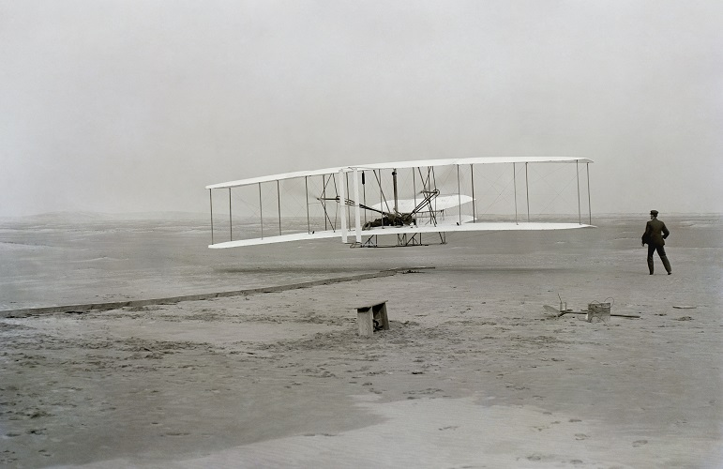
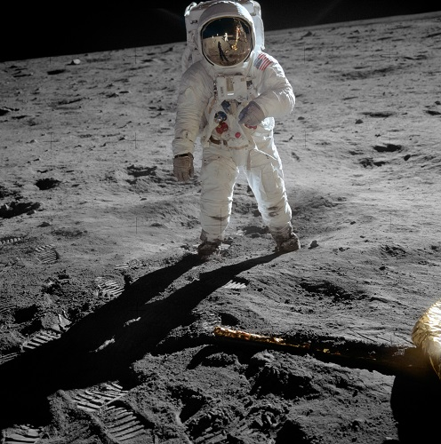
4 Summary and Discussions
66 years

Slide 67
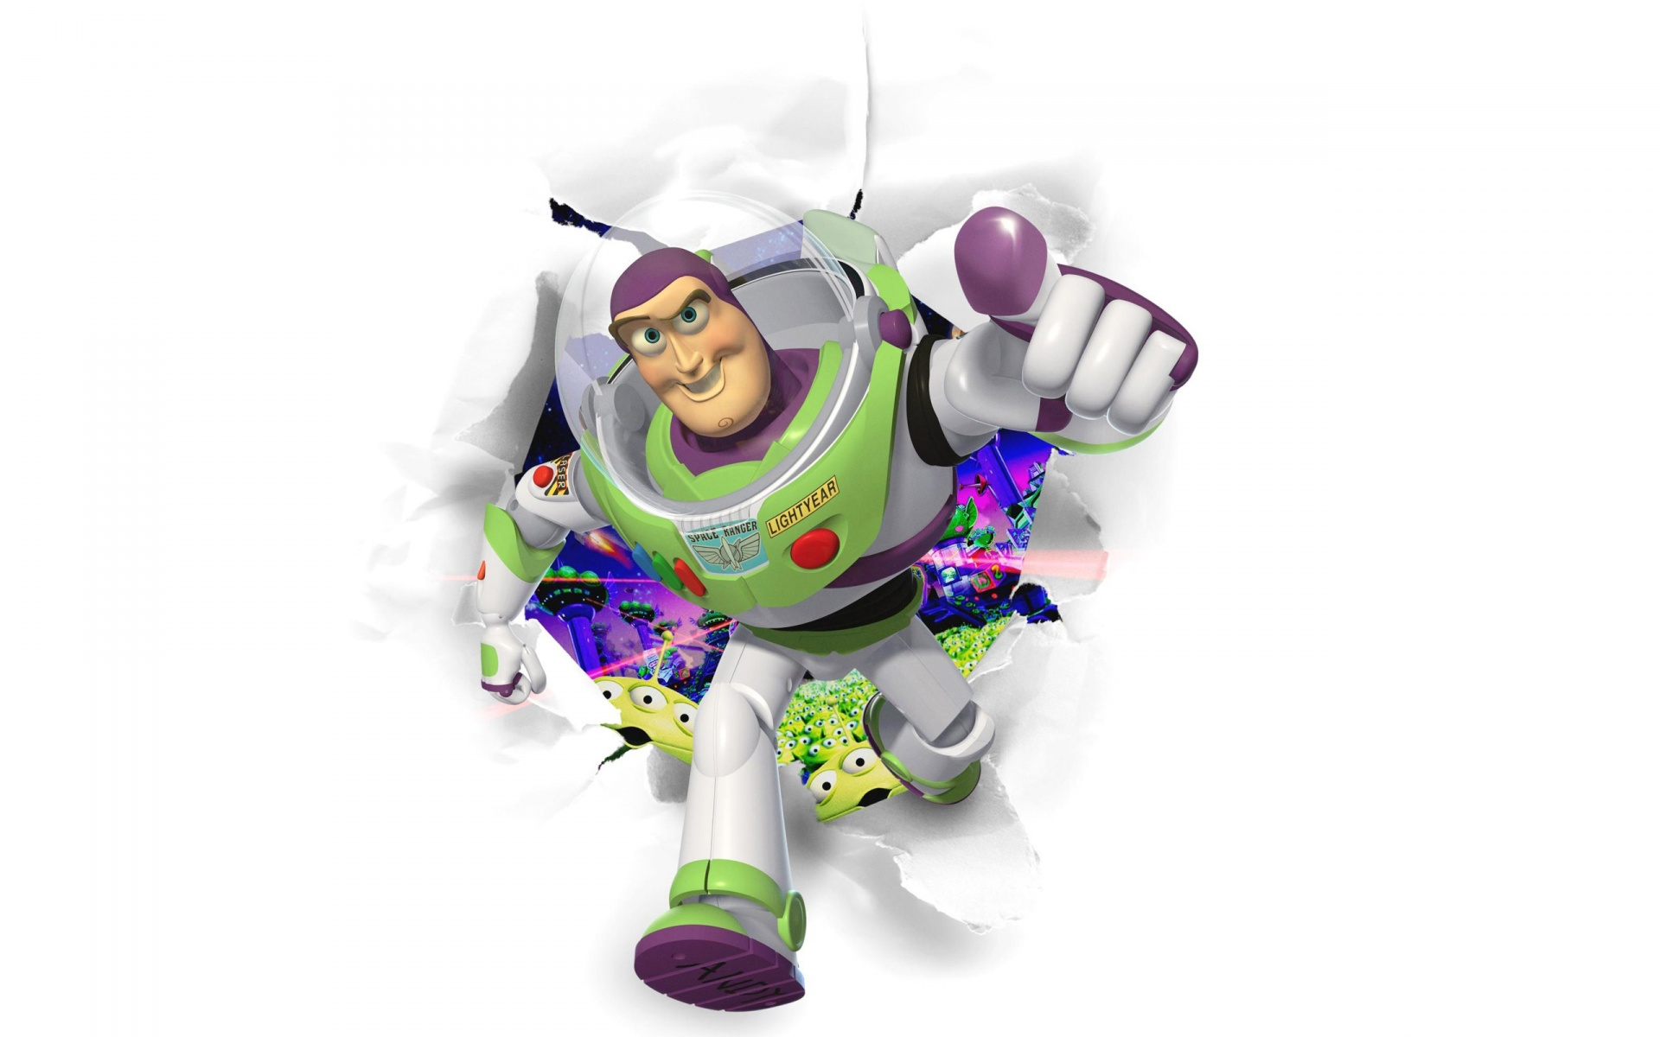
To Infinity,
and Beyond!

Slide 68
Contents
Abstract and Introduction
1 Team Management
2 Design and Engineering Challenges
2.1 Team Management of XRISM
2.2 Instruments onboard XRISM
2.2.1 XMA (X-ray Mirror Assembly)
2.2.2 Resolve
2.2.3 Xtend
2.2.4 Parameters, Effective Area, Energy Resolution
2.3 AOCS (Attitude and Orbit Control System)
3 Science Goals
4 Summary and Discussions
References

Slide 69
References
[1]Official Websitehttps://xrism.isas.jaxa.jp/en/
[2]Wikipediahttps://en.wikipedia.org/wiki/X-Ray_Imaging_and_Spectroscopy_Mission
[3]2003.04962
[4]2106.01611
[5]2202.05399
[6]https://doi.org/10.1016/j.cryogenics.2019.103016
[7]1906.00171
[8]2007.07608
[9]2009.06246
[10]2104.07241
[11]2112.14176
[12]2207.00512
[13]https://www.researchgate.net/publication/347601842
[14]https://ieeexplore.ieee.org/document/629809

Slide 70
References
[15]2207.13731
[16]2207.10686
[17]2206.15074
[18]2206.07134
[19]2205.08894
[20]2202.01236
[21]2201.12370
[22]2201.07607
[23]2111.12838
[24]2111.00065
[25]2109.12699
[26]2109.04184
[27]2108.07343
[28]2108.04847
[29]2106.13258
[30]2103.13242
[31]2103.07602
[32]2103.05891
[33]2103.05807
[34]2102.12164
[35]2102.11510
[36]2012.02041
[37]2010.02312
[38]2009.13524
[39]2009.03344
[40]2009.00643
[41]2007.07260
[42]2004.12924
[43]2003.00148
[44]2001.11915
[45]2001.10643
[46]1912.01012
[47]1911.01660
[48]1910.11317
[49]1908.08023
[50]1906.08653
[51]1905.00916
[52]1904.11028
[53]1904.06248
[54]1903.11608
[55]1903.08213
[56]1903.06458
[57]1903.06356
[58]1902.00024
[59]1811.01967
[60]1810.05168
[61]1807.06903
[62]1912.07897
[63]2011.08230

Slide 71
References
Why not write formal References?
[13]Makoto Tashiro, Hironori Maejima, Kenichi Toda, Richard Kelley, Lillian Reichenthal, Leslie Hartz, Robert Petre, Brian Williams, Matteo Guainazzi, Elisa Costantini, Ryuichi Fujimoto, Kiyoshi Hayashida, Joy Henegar-Leon, Matt Holland, Yoshitaka Ishisaki, Caroline Kilbourne, Mike Loewenstein, Kyoko Matsushita, Koji Mori, Takashi Okajima, F. Scott Porter, Gary Sneiderman, Yoh Takei, Yukikatsu Terada, Hiroshi Tomida, Hiroya Yamaguchi, Shin Watanabe, Hiroki Akamatsu, Yoshitaka Arai, Marc Audard, Hisamitsu Awaki, Iurii Babyk, Aya Bamba, Nobutaka Bando, Ehud Behar, Thomas Bialas, Rozenn Boissay-Malaquin, Laura Brenneman, Greg Brown, Edgar Canavan, Meng Chiao, Brian Comber, Lia Corrales, Renata Cumbee, Cor de Vries, Jan-Willem den Herder, Johannes Dercksen, Maria Diaz-Trigo, Michael DiPirro, Chris Done, Tadayasu Dotani, Ken Ebisawa, Megan Eckart, Dominique Eckert, Satoshi Eguchi, Teruaki Enoto, Yuichiro Ezoe, Carlo Ferrigno, Yutaka Fujita, Yasushi Fukazawa, Akihiro Furuzawa, Luigi Gallo, Nathalie Gorter, Martin Grim, Liyi Gu, Kouichi Hagino, Kenji Hamaguchi, Isamu Hatsukade, David Hawthorn, Katsuhiro Hayashi, Natalie Hell, Junko Hiraga, Edmund Hodges-Kluck, Takafumi Horiuchi, Ann Hornschemeier, Akio Hoshino, Yuto Ichinohe, Sayuri Iga, Ryo Iizuka, Manabu Ishida, Naoki Ishihama, Kumi Ishikawa, Kosei Ishimura, Tess Jaffe, Jelle Kaastra, Timothy Kallman, Erin Kara, Satoru Katsuda, Steven Kenyon, Mark Kimball, Takao Kitaguchi, Shunji Kitamoto, Shogo Kobayashi, Akihide Kobayashi, Takayoshi Kohmura, Aya Kubota, Maurice Leutenegger, Muzi Li, Tom Lockard, Yoshitomo Maeda, Maxim Markevitch, Connor Martz, Hironori Matsumoto, Keiichi Matsuzaki, Dan McCammon, Brian McLaughlin, Brian McNamara, Joseph Miko, Eric Miller, Jon Miller, Kenji Minesugi, Shinji Mitani, Ikuyuki Mitsuishi, Misaki Mizumoto, Tsunefumi Mizuno, Koji Mukai, Hiroshi Murakami, Richard Mushotzky, Hiroshi Nakajima, Hideto Nakamura, Kazuhiro Nakazawa, Chikara Natsukari, Kenichiro Nigo, Yusuke Nishioka, Kumiko Nobukawa, Masayoshi Nobukawa, Hirofumi Noda, Hirokazu Odaka, Mina Ogawa, Takaya Ohashi, Masahiro Ohno, Masayuki Ohta, Atsushi Okamoto, Naomi Ota, Masanobu Ozaki, Stephane Paltani, Paul Plucinsky, Katja Pottschmidt, Michael Sampson, Takahiro Sasaki, Kosuke Sato, Rie Sato, Toshiki Sato, Makoto Sawada, Hiromi Seta, Yasuko Shibano, Maki Shida, Megumi Shidatsu, Shuhei Shigeto, Keisuke Shinozaki, Peter Shirron, Aurora Simionescu, Randall Smith, Kazunori Someya, Yang Soong, Keisuke Sugawara, Yasuharu Sugawara, Andy Szymkowiak, Hiromitsu Takahashi, Toshiaki Takeshima, Toru Tamagawa, Keisuke Tamura, Takaaki Tanaka, Atsushi Tanimoto, Yuichi Terashima, Yohko Tsuboi, Masahiro Tsujimoto, Hiroshi Tsunemi, Takeshi Tsuru, Hiroyuki Uchida, Yuusuke Uchida, Hideki Uchiyama, Yoshihiro Ueda, Shinichiro Uno, Jacco Vink, Tomomi Watanabe, Michael Witthoeft, Rob Wolfs, Shinya Yamada, Kazutaka Yamaoka, Noriko Yamasaki, Makoto Yamauchi, Shigeo Yamauchi, Keiichi Yanagase, Tahir Yaqoob, Susumu Yasuda, Tessei Yoshida, Nasa Yoshioka, Irina Zhuravleva, "Status of x-ray imaging and spectroscopy mission (XRISM)," Proc. SPIE 11444, Space Telescopes and Instrumentation 2020: Ultraviolet to Gamma Ray, 1144422 (13 December 2020); https://doi.org/10.1117/12.2565812

